Slide 1
It does not matter how slowly you go so long as you do not stop.
– Confucius
Lecture 14 – Introduction to Divide and Conquer
CST370 – Design & Analysis of Algorithms
Dr. Byun
Computer Science

Slide 2
Lecture Objectives
After completion of this lecture, you will be able to
  explain the basic idea of divide-and-conquer technique.
  use the Master Theorem to determine the time efficiency of a divide-and-conquer algorithm.
Note that we cover Chapter 5 first. We will then cover Chapter 4.

Slide 3
Chapter 5: Divide-and-Conquer
5.1 Mergesort
5.2 Quicksort
5.3 Binary Tree Traversals and Related Properties
5.4 Multiplication of Large Integers and Strassen’s Matrix Multiplication
5.5 The Closest-Pair and Convex-Hull Problems by Divide-and-Conquer

Slide 4
Introduction to Divide and Conquer
Watch this video first
  https://youtu.be/_ZkJ3vtdg6Y
One of the best-known problem solving techniques.
  A problem is divided into several subproblems. Typically, it is divided into two subproblems.
  Subproblems are solved (recursively).
  If it’s necessary, the subproblems’ solutions are combined (or conquered) to get the solution of the original problem.

Slide 5
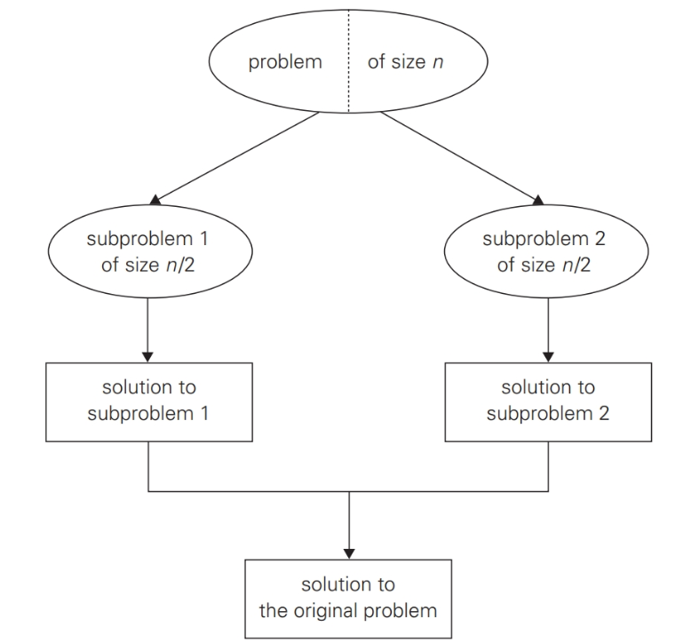
Divide-and-conquer technique – Typical Case

Slide 6
Divide and Conquer – Example
Assume that we want to calculate the sum of n numbers in an array of a₀, a₁, …, a_{n-1}.
  If n is 1, we return the number as a result.
  Otherwise, we divide the n numbers into two subproblems with (n/2) numbers and (n/2) numbers.
  The two subproblems are solved recursively.
  Then, we add the results of two subproblems.

Slide 7
Sample C++ Program
// https://repl.it/@YBYUN/sumdivNconqcpp
// Sum the array A from start to end indexes
int sum_div_N_conq(int A[ ], int start, int end) {
if (start == end)
return A[start];
else {
int sum1 = sum_div_N_conq (A, start, (start+end)/2);
int sum2 = sum_div_N_conq (A, (start+end)/2+1, end);
return(sum1 + sum2);
}
}
int main() {
int A[8] = {5, 3, 2, 7, 6, 1, 8, 4};
cout << sum_div_N_conq (A, 0, 7) << endl;
return 0;
}

Slide 8
<<< Course Instruction >>>
Read the following document named “Introduction to Divide-and-Conquer” to get the basic idea of divide-and-conquer.
  https://goo.gl/ySZavW

Slide 9
Time Efficiency of Divide and Conquer Algorithm
Watch this video first
  https://youtu.be/rjzS9r7dH98
A typical divide-and-conquer algorithm uses a recursive function.
Example
  int sum_div_N_conq (int A[ ], int start, int end) {
  if (start == end)
  return A[start];
  else {
  int sum1 = sum_div_N_conq (A, start, (start+end)/2);
  int sum2 = sum_div_N_conq (A, (start+end)/2+1, end);
  return(sum1 + sum2);
  }
  }
We will use Master Theorem to get the time efficiency of a divide-and-conquer algorithm.

Slide 10
Informal Usage of Master Theorem (1 of 2)
To apply Master Theorem for a divide and conquer algorithm, we have to know three items named b, a, and d.
  b: number of subproblems.
  a: number of subproblems to be solved.
  d is the number in Θ(n^{d}) in which Θ(n^{d}) is the time to divide and conquer (or combine) the original problem of size n.

Slide 11
Informal Usage of Master Theorem (2 of 2)
Example
  int sum_div_N_conq (int A[ ], int start, int end) {
  if (start == end)
  return A[start];
  else {
  int sum1 = sum_div_N_conq (A, start, (start+end)/2);
  int sum2 = sum_div_N_conq (A, (start+end)/2+1, end);
  return(sum1 + sum2);
  }
  }
b=2 (Number of subproblems)
a=2 (Number of subproblems to be solved)
d=0 (Time to divide and conquer is Θ(1). Note that Θ(1) is the same as Θ(n⁰))

Slide 12
Basic Idea of Master Theorem
Case 1: If a < b^{d}, then Θ(n^{d})
Case 2: If a = b^{d}, then Θ(n^{d} * log n)
Case 3: If a > b^{d}, then Θ(n^{log}bª)
Our example: a=2, b=2, d=0

Slide 13
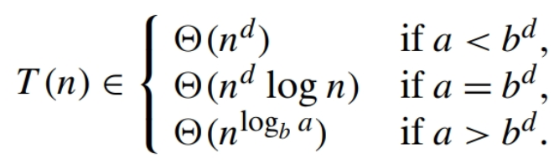
Exercise
Assume that we have a divide and conquer algorithm with three numbers like this:
  a = 4, b = 2, d = 2.
Present the time complexity of the algorithm.
  This is the Master Theorem for your reference.

Slide 14
Master Theorem
So far, we talk about the Master Theorem briefly.
Read the following document to get the basic idea of the theorem more formally.
  https://goo.gl/zktCvU

Slide 15

Summary – Divide-and-Conquer Recurrence
Assume an instance of size n.
  Smaller instance size: n/b (= we have b smaller instances).
  Among b instances, we should solve a instances.
  f(n): Time for dividing and combining the solutions.
Example
  Sum of n numbers: a=2, b=2, f(n) = Θ(1)

Slide 16

Summary – Master Theorem
, where

Slide 17
Exercise
Assume that we have a divide and conquer algorithm with the recurrence relation like below
  T(n) = 2*T(n/2) + 5*n³+7*n
Present the values of a, b, and d.
  Then, identify the time complexity of the algorithm.

